Slide 1
Null and Alternative Hypotheses
hypothesis
A statement expressing an opinion based on incomplete evidence
A tentative insight into the natural world
A concept that is not yet verified but it’s true would explain certain facts or phenomena
Convert the research question to null and alternative hypotheses
The null hypothesis (H₀) is a claim of “no difference in the population”
The alternative hypothesis (H_{a}) claims “H₀ is false”
Collect data and seek evidence against H₀ as a way of bolstering H_{a} (deduction)
Notes:
Chapter 9
Basic Biostat
The following four steps outline the process of hypothesis testing and introduce some of the new terminology:
The first step in the procedure is to state the hypotheses null and alternative forms. The null hypothesis (abbreviate “H naught”) is a statement of no difference. The alternative hypothesis (“H sub a”) is a statement of difference. Seek evidence against the claim of H₀ as a way of bolstering H_{a.}
The next slide offers an illustrative example on setting up the hypotheses.

Slide 2
Hypothesis Testing
The purpose of the hypothesis test is to decide between two explanations:
The difference between the sample and the population can be explained by sampling error (there does not appear to be a treatment effect)
The difference between the sample and the population is too large to be explained by sampling error (there does appear to be a treatment effect).

Slide 3
Hypothesis Testing Steps
  Null and alternative hypotheses
  Test statistic
  P-value and interpretation
  Significance level (optional)

Slide 4
Step 1
State the hypotheses and select an α level. The null hypothesis, H0, always states that the treatment has no effect (no change, no difference). According to the null hypothesis, the population mean after treatment is the same is it was before treatment. The α level establishes a criterion, or "cut-off", for making a decision about the null hypothesis. The alpha level also determines the risk of a Type I error.

Slide 5
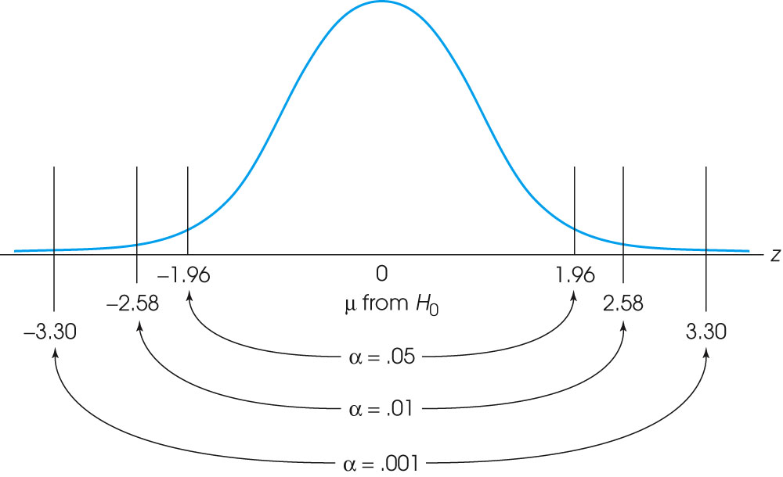
The locations of the critical region boundaries for three different levels of significance: α = .05, α = .01, and α = .001.
Notes:
Figure 8.5
The locations of the critical region boundaries for three different levels of significance: α = .05, α = .01, and α = .001.

Slide 6
Step 2
Locate the critical region. The critical (rejection) region consists of outcomes that are very unlikely to occur if the null hypothesis is true. That is, the critical region is defined by sample means that are almost impossible to obtain if the treatment has no effect. The phrase “almost impossible” means that these samples have a probability (p) that is less than the alpha level.

Slide 7
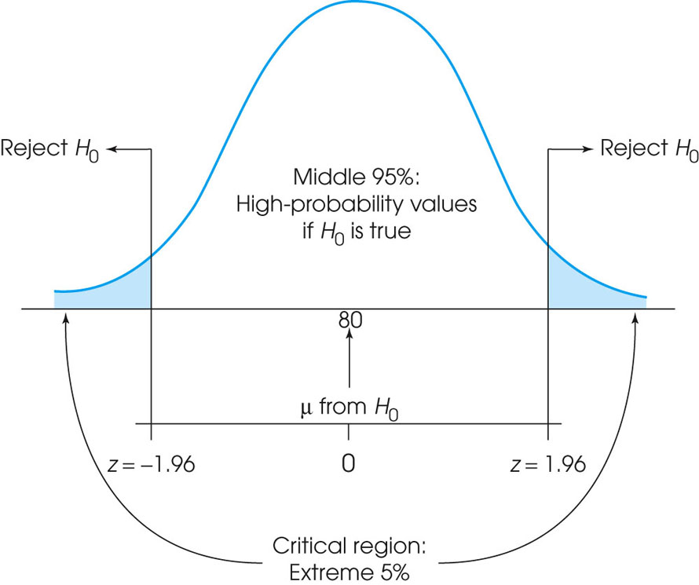
The critical region (very unlikely outcomes) for α = .05.
  Rejection region - Values of the test statistic for which we reject the null in favor of the alternative hypothesis
Notes:
Figure 8.4
The critical region (very unlikely outcomes) for α = .05.

Slide 8
Step 3
  Compute the test statistic (a z-score) . Test statistic - Quantity based on sample data and null hypothesis used to test between null and alternative hypotheses
The test statistic forms a ratio comparing the obtained difference between the sample mean and the hypothesized population mean versus the amount of difference we would expect without any treatment effect (the standard error).

Slide 9
Step 4
A large value for the test statistic shows that the obtained mean difference is more than would be expected if there is no treatment effect. If it is large enough to be in the critical region, we conclude that the difference is significant or that the treatment has a significant effect. In this case we reject the null hypothesis. If the mean difference is relatively small, then the test statistic will have a low value. In this case, we conclude that the evidence from the sample is not sufficient, and the decision is fail to reject the null hypothesis.

Slide 10
Directional Tests
When a research study predicts a specific direction for the treatment effect (increase or decrease), it is possible to incorporate the directional prediction into the hypothesis test.
The result is called a directional test or a one-tailed test. A directional test includes the directional prediction in the statement of the hypotheses and in the location of the critical region.
For example, if the original population has a mean of μ = 80 and the treatment is predicted to increase the scores, then the null hypothesis would state that after treatment:
H0: μ < 80 (there is no increase)
In this case, the entire critical region would be located in the right-hand tail of the distribution because large values for M would demonstrate that there is an increase and would tend to reject the null hypothesis.

Slide 11
P value
We can make a point estimate and a confidence interval.
What’s a p value?
  Significant p value is an arbitrary number.
  Does NOT measure the strength of association.
  Measures the likelihood that the observed estimate is due to random sampling error.
  P < 0.05 is, by convention, an indication of ‘statistical significance’.
  The P value answer the question: What is the probability of the observed test statistic or one more extreme when H₀ is true?

Slide 12
Interpretation
P-value answer the question: What is the probability of the observed test statistic … when H₀ is true?
Thus, smaller and smaller P-values provide stronger and stronger evidence against H₀
Small P-value ⇒ strong evidence

Slide 13
Interpretation
Conventions*
P > 0.10 ⇒ non-significant evidence against H₀
0.05 < P ≤ 0.10 ⇒ marginally significant evidence
0.01 < P ≤ 0.05 ⇒ significant evidence against H₀
P ≤ 0.01 ⇒ highly significant evidence against H₀
Examples
  P =.27 ⇒ non-significant evidence against H₀
  P =.01 ⇒ highly significant evidence against H₀
* It is unwise to draw firm borders for “significance”

Slide 14
Conclusions of a Test of Hypothesis
If we reject the null hypothesis, we conclude that there is enough evidence to infer that the alternative hypothesis is true.
If we do not reject the null hypothesis, we conclude that there is not enough statistical evidence to infer that the alternative hypothesis is true.
The alternative hypothesis is the more important one. It represents what we are investigating.

Slide 15
Seven Steps to Hypothesis Testing
Describe in words the population characteristic about which hypotheses are to be tested
State the null hypothesis, H_{o}
State the alternative hypothesis, H₁ or H_{a}
Display the test statistic to be used
Identify the rejection region
    Is it an upper, lower, or two-tailed test?
    Determine the critical value associated with α, the level of significance of the test
Compute all the quantities in the test statistic, and compute the test statistic itself
State the conclusion. That is, decide whether to reject the null hypothesis, H_{o}, or fail to reject the null hypothesis. The conclusion depends on the level of significance of the test. Also, remember to state your result in the context of the specific problem.

